Slide 1
Probability
EQ – How do I calculate the probability of an expected event?

Slide 2
24
7
30
Date
Probability
EQ – How do I calculate the probability of an expected event?
Complement of an Event= all outcomes that are NOT the event.
P(A) means "Probability of Event A“
P(A') means "Probability of the complement of Event A"
The complement is shown by a little mark after the letter such as A’
The two probabilities always add to 1
P(A) + P(A') = 1
You can use the probability of an event to predict the number of times an event might happen.
This is called expected frequency
Expected frequency = Probability x number of trials
Notes:
Input

Slide 3
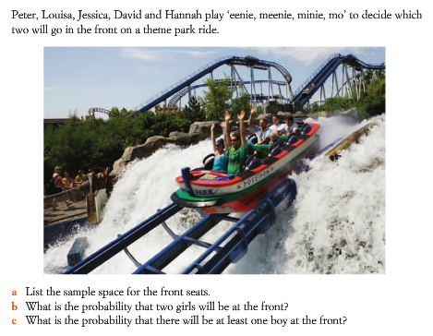
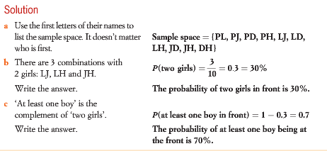
Example 2: We will do this together. Complete this in your Interactive notebook

Slide 4
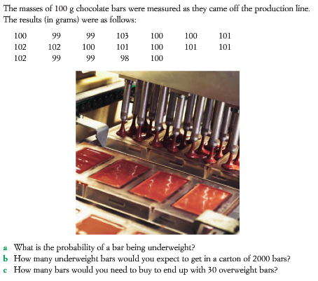
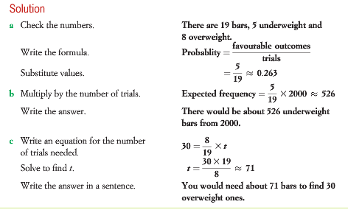
Example 1: We will do this together. Complete this in your Interactive notebook

Slide 5
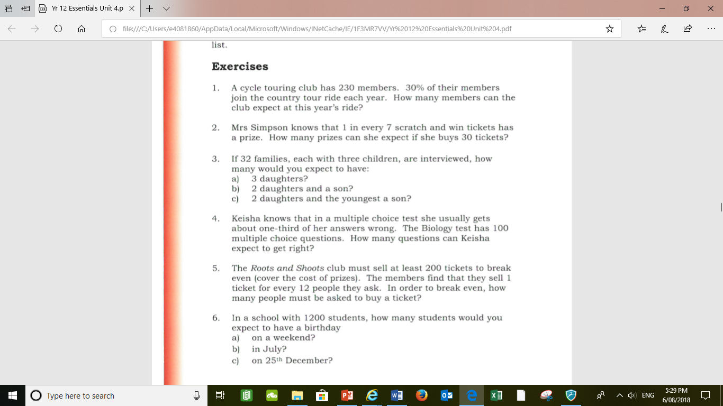
Your turn: Complete this in your Interactive notebook
MAWA textbook p140-141 Q1-8

Slide 6
Your turn: Complete this in your Interactive notebook
Notes:
Guided practice

Slide 7
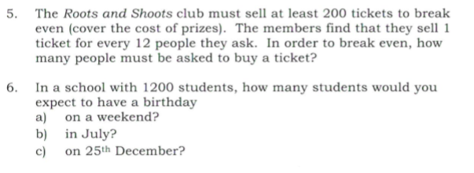
Your turn: Complete this in your Interactive notebook

Slide 8
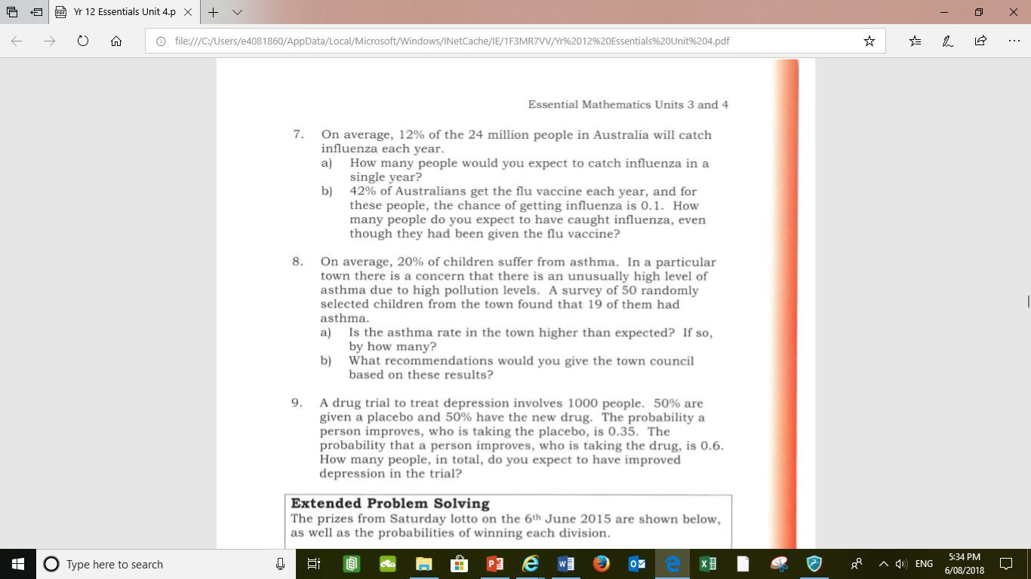

Slide 9
